Slide 1

Autonomous ground systems for phenology monitoring: PAR@METER & PASTiS57
F. Baret, O. Marloie, J.F. Hanocq,
B. de Solan, D. Guyon, A. Ducoussou

Slide 2
Introduction
Need for continuous monitoring of foliage development and senescence from ground for:
  Phenology modeling
  satellite products validation and calibration, including phenology products
  Phenotyping tree species
If possible accessing GAI
    LAI: green leaf area (one sided) per unit horizontal ground area
    GAI: half the developed area of the convex hull wrapping green vegetation elements per unit ground area
    PAI: half the developed area of the convex hull wrapping vegetation (including non green) elements per unit ground area
Based on light transmittance measurements
Need low cost units for better spatial sampling

Slide 3
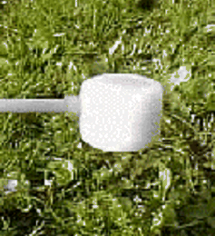
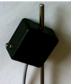
The sensors
Criterions | Hemispherical PAR sensors | Directional blue photodiode sensors
PAI estimates | Yes | Yes
PAR measurement | Yes | No
Albedo measurements | Yes | No
Sensitivity to illumination conditions | Yes (sun position, diffuse fraction) | No
Sensitivity to leaf clumping (for PAI estimates) | Yes | restricted
Spatial sampling | Larger (±90°) | Restricted (±20°)
Cost | 50€ | 25€

Slide 4

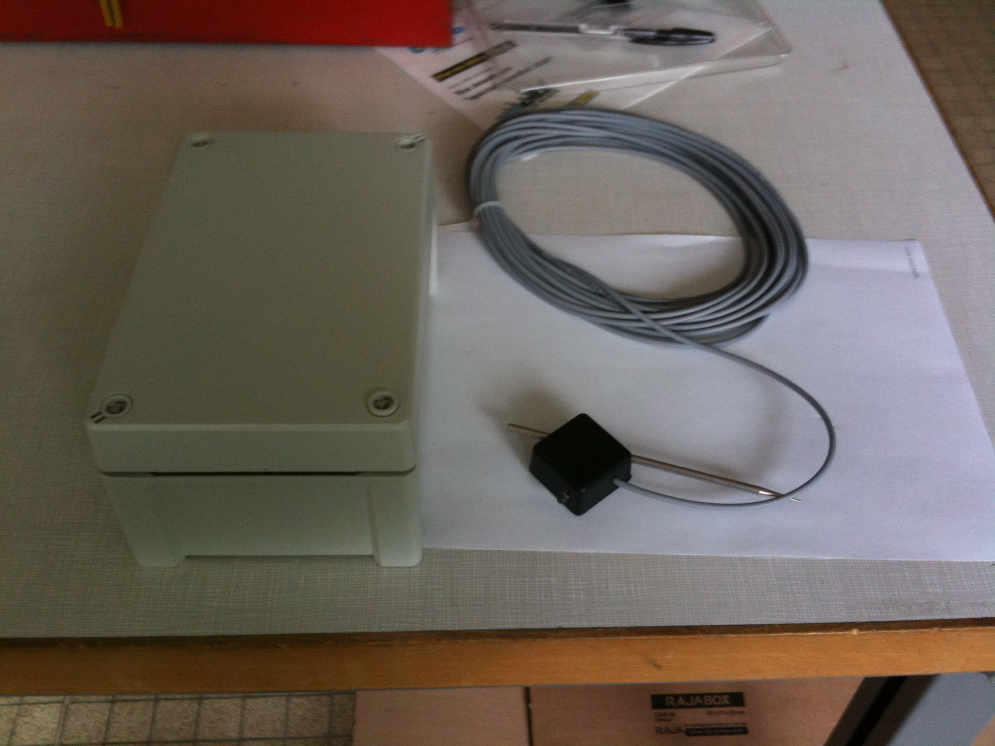
The recording systems
 | Wifi network | Independent units
Autonomy | 1 month (master) | 3 months
Ease for data recording | +++ | +
Realibility | + | +++
Installation | + | +++
Synchronization with irradiance meas. | +++ | ++
Maximum distance with irradiance meas. | 400m | 1-5 kms
Internet conection | Yes | No
Cost per recording unit | 150€ (for 4 sensors) | 100€ (for 6 sensors)
Cost for ESU sampling (12 sensors) | 1000€ | 500€

Slide 5
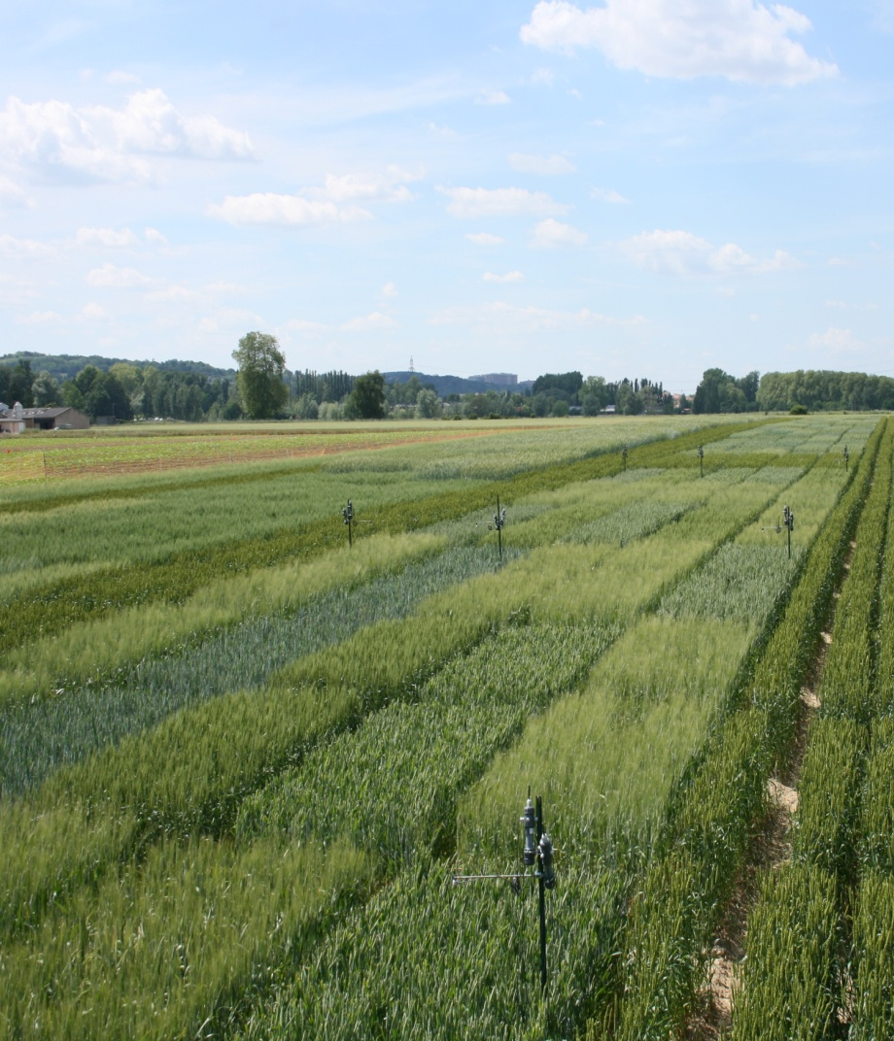
PAR@METER
Better suited for agriculture

Slide 6
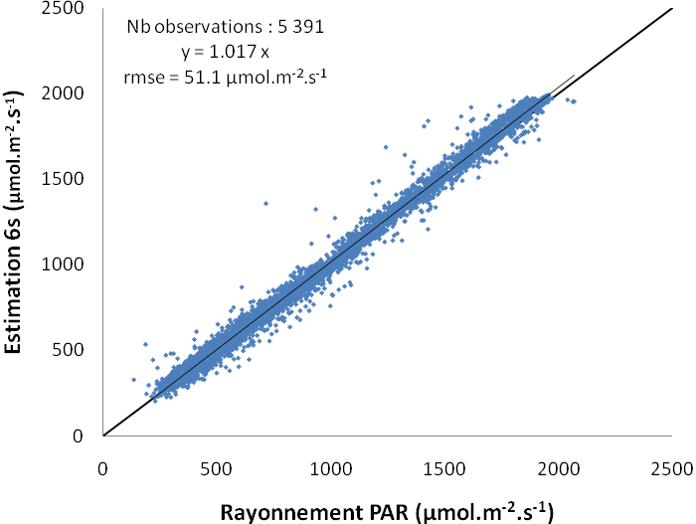
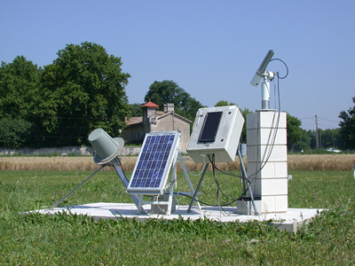
Absolute calibration based on AERONET measurements
6S
Absolute calibration needed
for diffuse fraction estimation

Slide 7
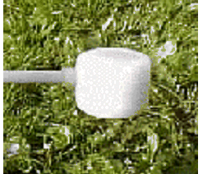
Estimates of the diffuse fraction from irradiance measurements
based on 6S model simulations
exo-atmosphéric
radiation
NNT(6S)
Date, Hour
PARi
Less accurate when partially cloudy sky

Slide 8
PAI estimation
Transmittance
PARt/PARi
Hemispherical extinction
coefficient
Diffuse
fraction
Directionnal extinction
coefficient
Adjusting ALA and PAI over a temporal window of few days
The Poisson model is currently used under randomly distributed vegetation elements
The radiative transfer model may be refined for specific vegetation types

Slide 9
Some results

Slide 10
Additional results
PAR balance over Wheat crop
LAI dynamics over maize crops

Slide 11
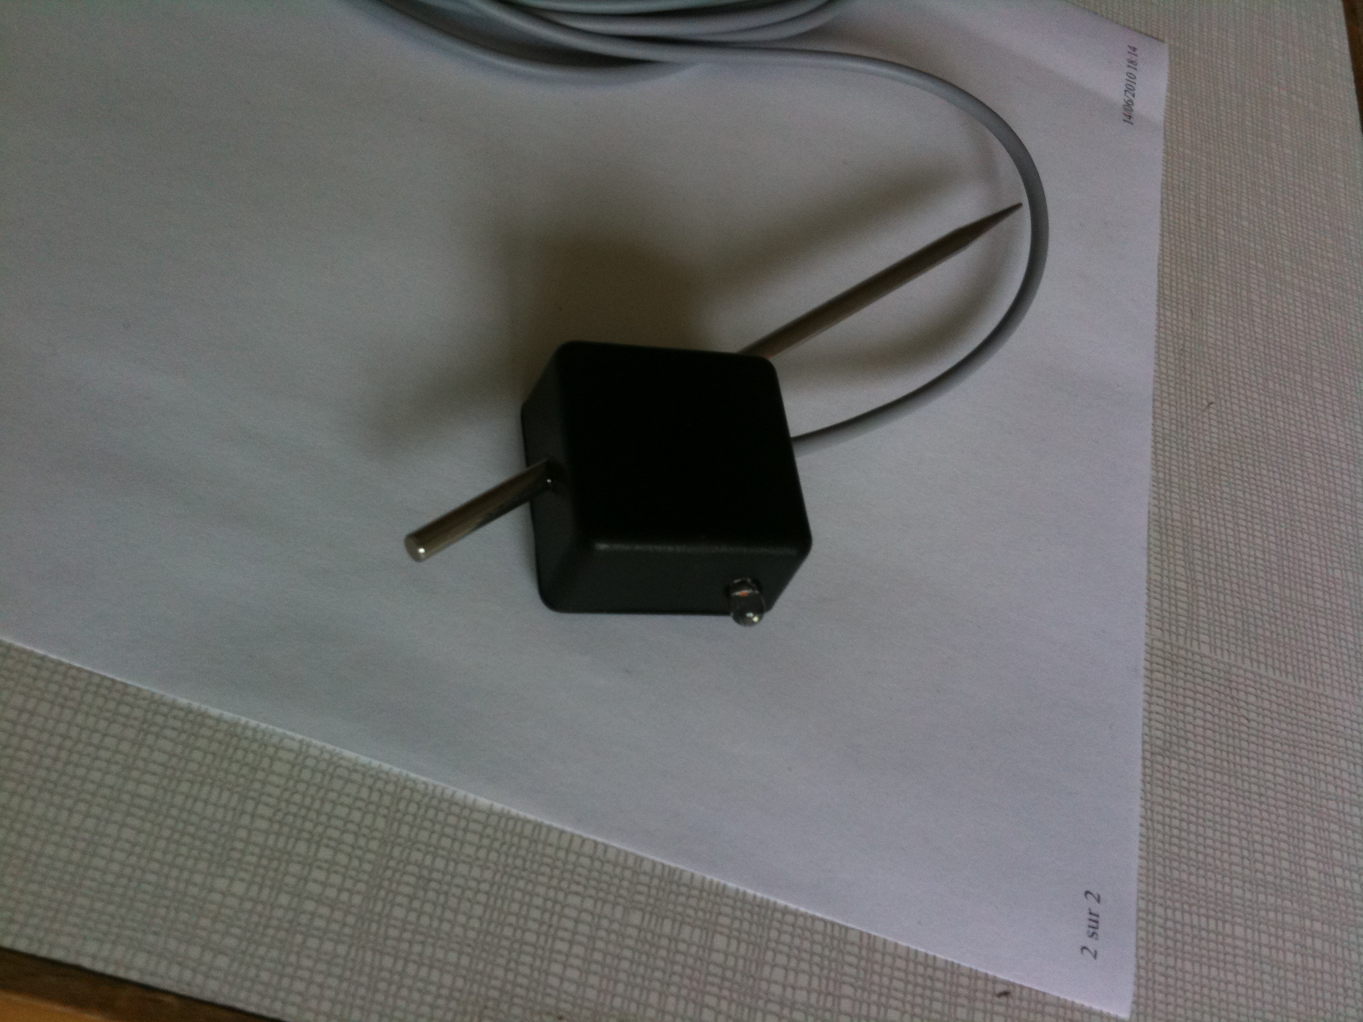
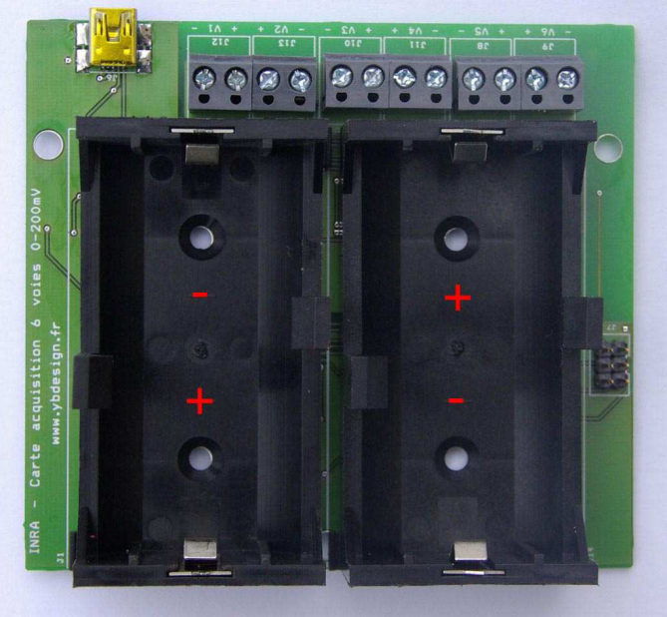
PASTiS57
10m
6m
6m
10m
2m
2m

Slide 12
Comparison with PAR sensors
Clear sky
Full cloud
cover
Full cloud cover
Clear sky

Slide 13
Why 57° towards North in the blue?
Why blue spectral domain?
  Better contrast between vegetation (almost black) and sky (rayleigh and aerosol scattering)
  Limits multiple scattering in the canopy
Interest of 57°
  Minimization of leaf angle distribution effect
  Minimization of plant clumping effect
  Compromise between sensitivity (short path length) and spatial sampling (longer path length)
Why North orientation?
  Avoids direct sun light
  Reverse to South in the southern hemisphere!

Slide 14
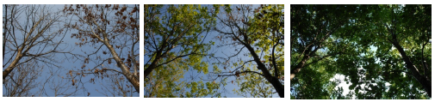
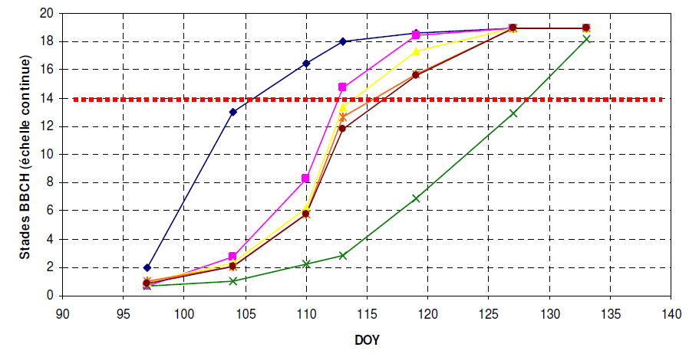
Some results on phenology: direct ground observations
14 April
7 May
22 June

Slide 15
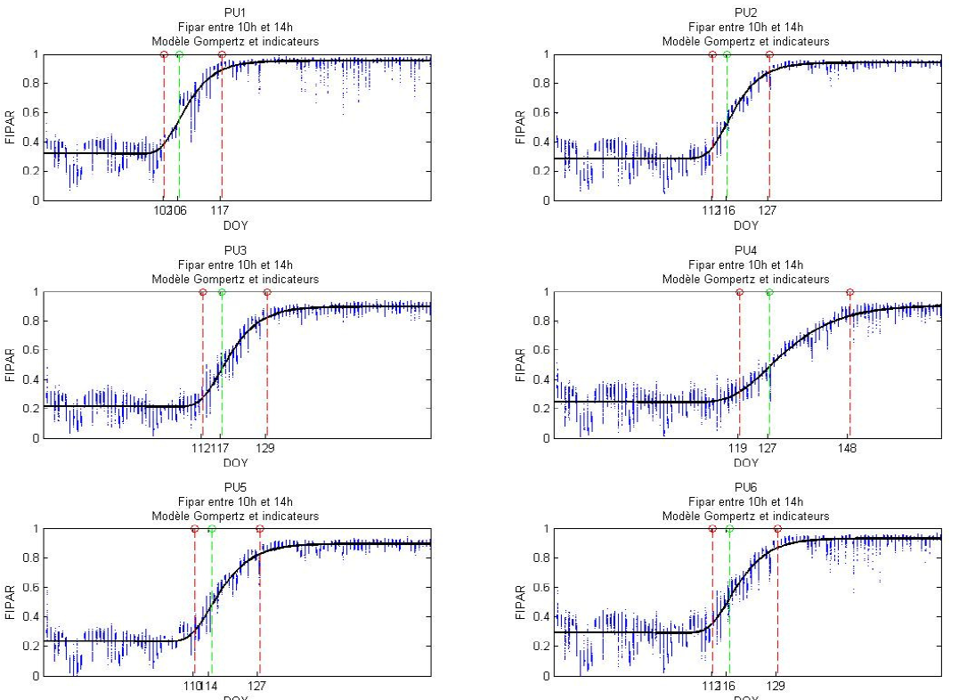
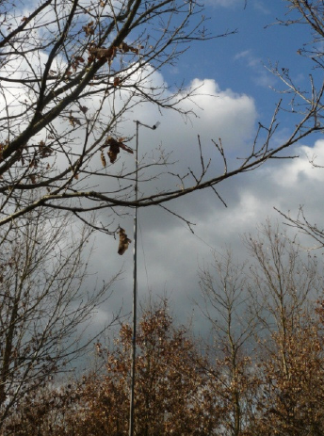
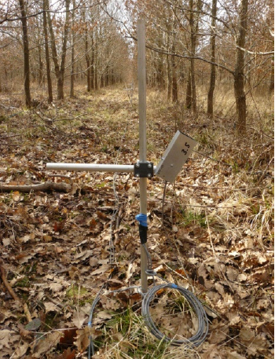
Typical dynamics measured by the sensors
Incident
Transmitted
Prototype sensors (PAR domain, 40° zenith angle)

Slide 16
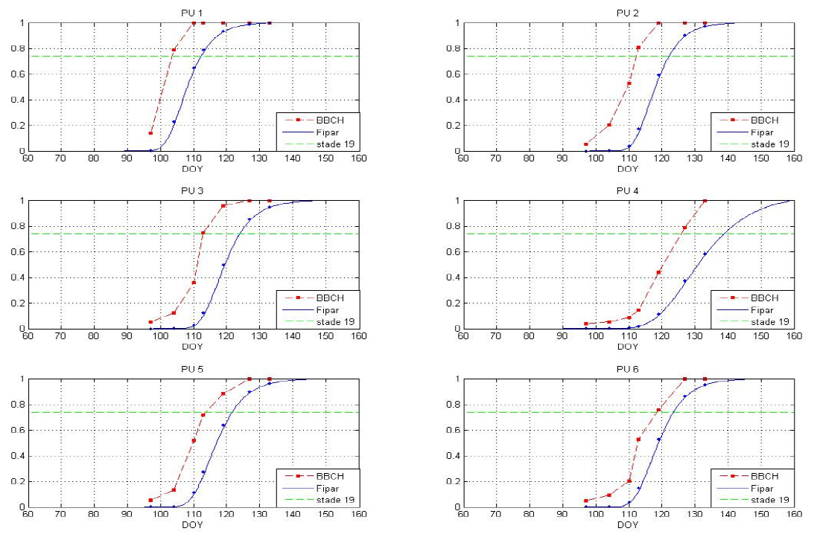
Comparison with visual notations

Slide 17
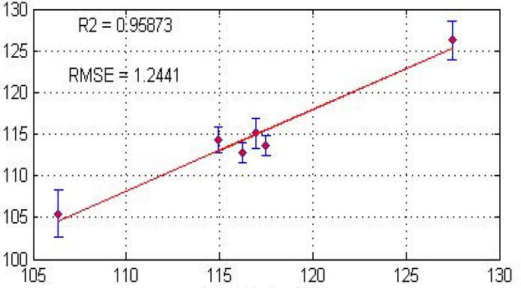
Performances of stages estimates
Date of inflection of BBCH Stage 19
Date of inflection from sensors

Slide 18
Conclusion
(Relatively) low cost systems are now available for ground measurements of leaf development:
    LAI
    FAPAR
    Albedo (PAR or PIR)
Good performances with regards to visual estimates of phenology (but need confirmation)
Few 3x3 km² sites are/will be equipped in 2010
  Barrax / Crau / Foret de Harth / Hyatt&$@la / Poland

Slide 19
Questions
From which product? (NDVI, EVI, @!VI, LAI, fAPAR, fCover
Which model(s) of dynamics and fitting/smoothing/interpolation?
Which metrics derived from continuous dynamics
Propose transfer functions from ground to satellite products
  Scaling issue
  Measurement/metrics issue

Slide 20
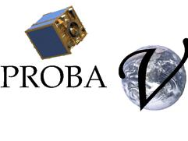
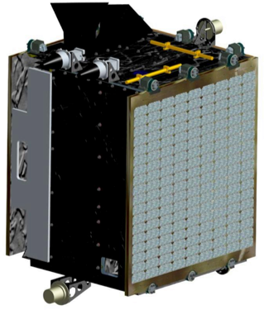
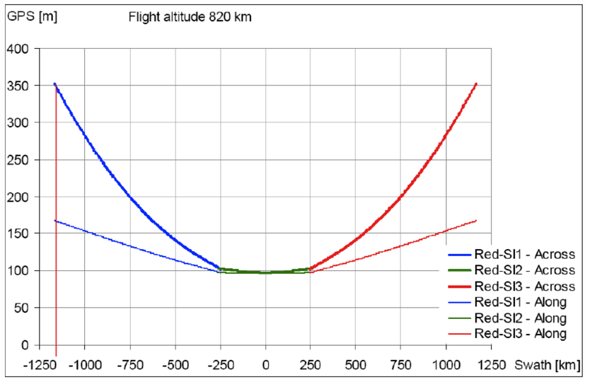
Need for support for PROBA-V 100m
Resolution: 300 m every day
100 m every 3 days
4 bands (Blue, red, NIR, SWIR (VEGETATION)
Launch in beginning 2014

